Slide 1
MIPS Software Standards (ABIs)
邹旭
2018.8.27

Slide 2
About MIPS ABI
The MIPS ABI took shape as a set of register usage and calling conventions established from the earliest days of MIPS CPUs
o32: grew from traditional MIPS conventions(‘o’ for old), o32 is widely used today.
n64: new formal ABI for 64-bit programs on 64-bit CPUs running under Silicon Graphics’ Irix operating system.
n32: a partner ABI to n64, its for “32-bit” programs on 64-bit CPUs.

Slide 3
Data Representations and Alignment
Sizes of basic types
Size of ‘long’ and pointer types
Alignment requirements
Memory layout of basic types and how it changes with endianness
Bitfields in structures
Unaligned data from C

Slide 4
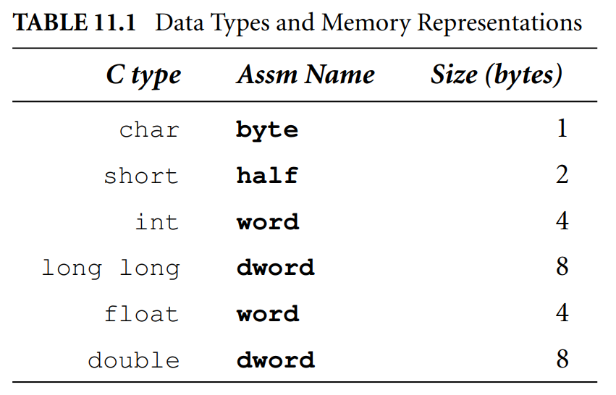
Data Representations and Alignment
Sizes of basic types

Slide 5
Data Representations and Alignment
Size of ‘long’ and pointer types
  A pointer is always stored like an unsigned long
  For o32/n32, long is implemented just like int
  For n64, long is implemented just like a long long

Slide 6
Data Representations and Alignment
Alignment requirements
  All these data are required to naturally aligned
    Two-byte datum: address 0 modulo 2
    Four-byte datum: address 0 modulo 4
    Eight-byte datum: address 0 modulo 8

Slide 7
Data Representations and Alignment
Memory layout of basic types and how it changes with endianness
  A data structure or array is aligned in memory to the largest alignment
  boundary required by any data type inside it
  Struct mixed {
  char c; /* byte 0, byte 1-7 are padding */
  double d; /* byte 8-15 */
  short s; /* byte 16-17, byte 18-23 are tail padding */
  }

Slide 8

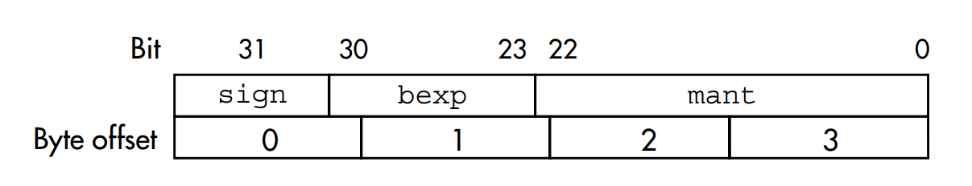

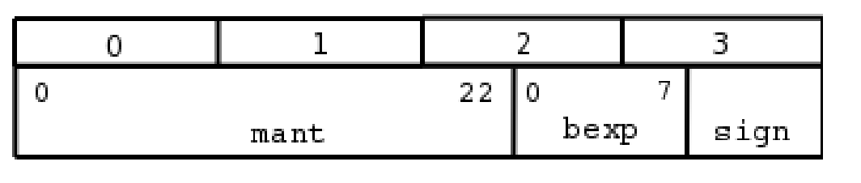
Data Representations and Alignment
Bitfields in structures
  structures that pack several short “bitfield” members into one or more locations of a standard integer type
  Exp:
  Big-endian
  Little-endian

Slide 9
Data Representations and Alignment
Bitfields in structures
  A bitfiled must reside entirely in a storage unit that is appropriate for its declared type
  Bitfields can share a storage unit with other structure members, including members that are not bitfields
  Using Unnamed zero-width field to force subsequent structure to occupy a new storage member

Slide 10
Data Representations and Alignment
Unaligned data from C
  GNU C
    __attribute__((__packed__))
    __attribute__((__aligned(n)__))
  ANSI standard
    #pragma pack(n)
    #pragma pack()

Slide 11
Argument passing and stack conventions for MIPS AIBs
The stack, subroutine linkage, and parameter passing
Stack argument structure in o32
Using registers to pass arguments
Examples from the C library
An exotic example: passing structure
Passing a variable number of arguments
Returning a value from a function
Evolving register-use standards: SGIs n32 and n64
Stack layouts, stack frames, and helping debuggers

Slide 12
Argument passing and stack conventions for MIPS AIBs
The stack, subroutine linkage, and parameter passing
  A principle:
  All arguments are allocated space in a data structure on the stack, but the contents that belong to the first few stack locations are in fact passed in CPU registers

Slide 13
Argument passing and stack conventions for MIPS AIBs
Stack argument structure in o32
  sp($29) must be eight-byte-aligned
  Allocate a minimum of 16 bytes of argument space
  Each argument occupies at least one word(32 bits)
  Double and long long must be aligned on an eight-byte boundary

Slide 14
Argument passing and stack conventions for MIPS AIBs
Using registers to pass arguments
  First 16 bytes of the argument structure are passed in registers a0-3($4-$7)
  The caller convert arguments to fixed types: int for integer values and double for floating-point
  It’s inefficient to carry FP values in integers registers. Unless the first argument is a floating-point type, no arguments can be passed in FP registers. //printf

Slide 15
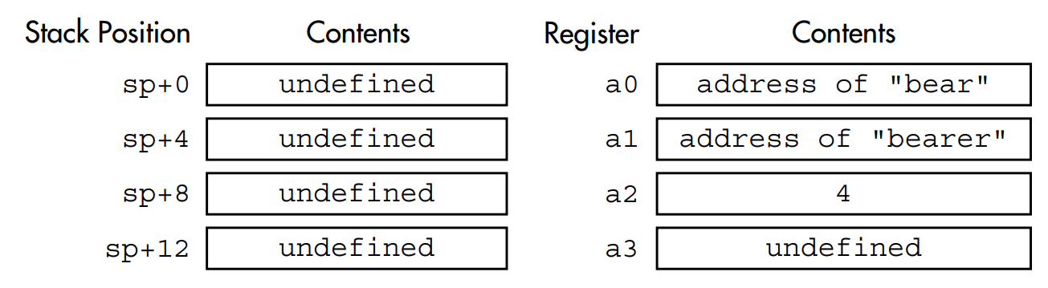
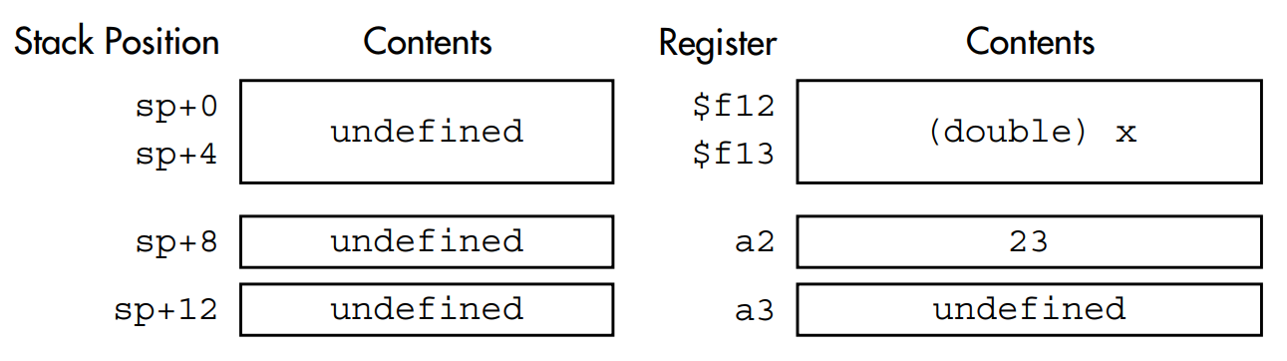
Argument passing and stack conventions for MIPS AIBs
Examples from the C library
  thesame = strncmp(“bear”, “bearer”, 4);
  Double ldexp(double, int);
  Y = ldexp(x, 23); /* y = x * (2**23) */

Slide 16
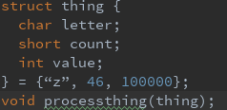
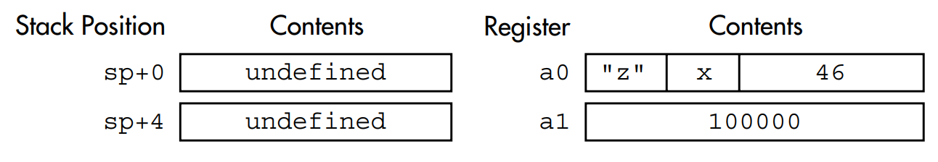
Argument passing and stack conventions for MIPS AIBs
An exotic example: passing structure

Slide 17
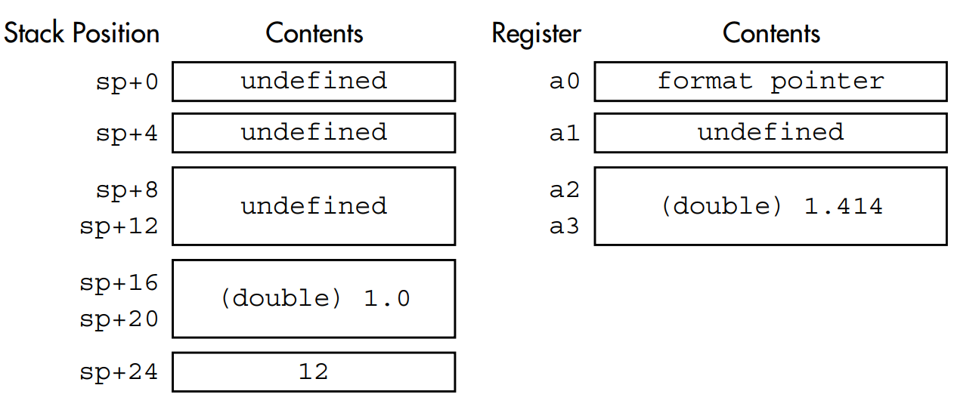
Argument passing and stack conventions for MIPS AIBs
Passing a variable number of arguments
  Unless the first argument is a floating-point type, no arguments can be passed in FP registers.

Slide 18
Argument passing and stack conventions for MIPS AIBs
Returning a value from a function
  An integer or pointer return value will be in register v0($2)
  Floating-point result comes back in register $f0
  For big structure, the caller makes a room on its stack for an anonymous structure valuable, and a pointer to that structure is stored in the implicit first argument.

Slide 19
Argument passing and stack conventions for MIPS AIBs
Evolving register-use standards: SGIs n32 and n64
  Up to eight arguments can be passed in registers
  Argument slots and therefore argument registers are 64 bits in size
  The caller does not allocate stack space for arguments passed in registers
  Any floating-point value that ends up occupying one of the first eight
  argument slots by itself is passed in an FP register
  n32 and n64 recognize 16-byte basic objects(such as long double
  floating-point), and such objects are 16-byte aligned.

Slide 20
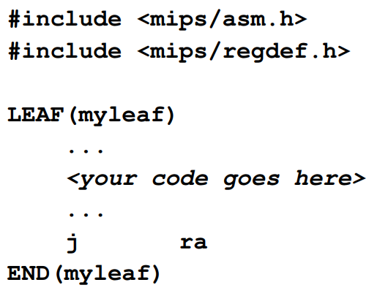
Argument passing and stack conventions for MIPS AIBs
Stack layouts, stack frames, and helping debuggers
    Leaf function

Slide 21
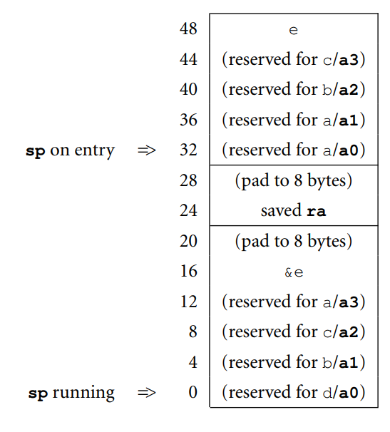
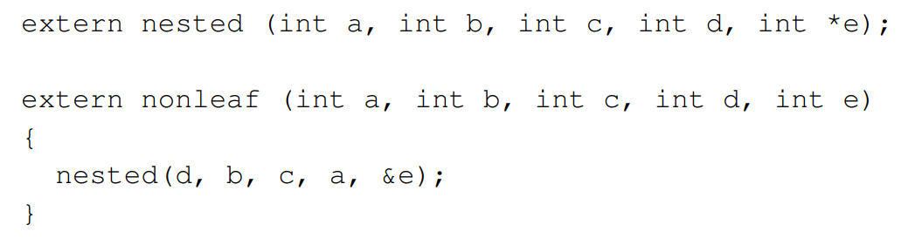
Argument passing and stack conventions for MIPS AIBs
Stack layouts, stack frames, and helping debuggers
    Leaf function
    Nonleaf function

Slide 22
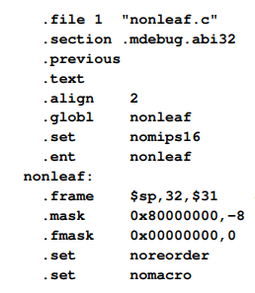
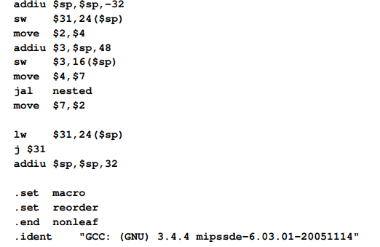
Argument passing and stack conventions for MIPS AIBs
Stack layouts, stack frames, and helping debuggers
    Leaf function
    Nonleaf function

Slide 23
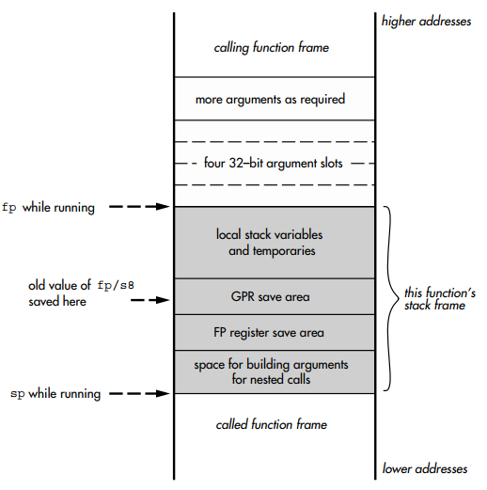
Argument passing and stack conventions for MIPS AIBs
Stack layouts, stack frames, and helping debuggers
    Leaf function
    Nonleaf function
    Frame pointers for more complex stack requirements

